Slide 1
Basic Statistics
John Pinney

Slide 2
Course Aims
By the end of this course, you will be better able to:
Understand the need for statistics, their uses and limitations.
Interpret graphical representations of sampled data
Calculate descriptive statistics for sampled data
Apply the normal distribution to answer questions about a population
Identify potential sources of bias in a scientific study

Slide 3
1. What is statistics?

Slide 4
The biggest question(s)...
What are statistics and why should we use them?
Can you name some common statistics we all encounter?

Slide 5
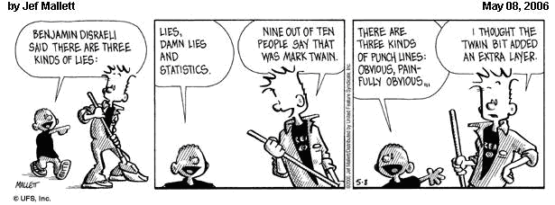

Slide 6
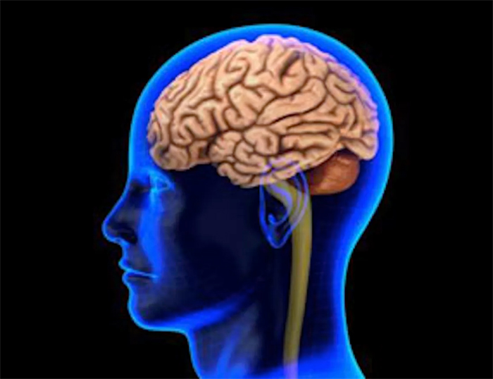
Statistics we encounter
Statistics rule the world…
Weather forecasting
All medicine (sample data + stats required to prove a medicine works!)
Election polls
Economic / financial forecasting (e.g. your wages, rent, council tax, utility bills, road tax)
Spotify, Facebook, Google, Instagram, Snapchat, news outlets, Amazon
University league tables
Prison sentences
University grades
London underground timetabling
“All” scientific discoveries
H&S rules
The internet

Slide 7
…but statistics handled incorrectly can lead to false conclusions!

Slide 8
The biggest answer(s)...
Statistics means handling data effectively:
collection, organisation, analysis, interpretation & presentation

Slide 9
The biggest answer(s)...
We use statistics to:
Analyse a full set of data to produce simple summary metrics (descriptive statistics)
Calculate something we can’t directly measure (inferential statistics)

Slide 10
Population vs sample
Population – the entire set you wish to learn something about (e.g. every child in the UK)
Sample – the set for which you have data for (e.g. the people who answer your questionnaire)
The population includes the sample… but a sample usually doesn’t cover the whole population!

Slide 11
Descriptive Statistics
Tools for analysing & interpreting sampled data and presentation of results
e.g. what is the average weight of a child who drinks 25 cans of fizzy drinks a day?
Can identify (and communicate):
Typical (central) values;
Shape and spread of the distribution of values;
Interesting patterns and relationships in the data.

Slide 12
Inferential Statistics
Use information on a sample of individuals to make inference about the wider population of like individuals.
You are investigating the Body Mass Index for children in the UK. You cannot study exhaustively the population of every child, due to money, time, effort etc… you restrict your investigation to a well chosen sample
With statistics, we can infer something about the population using only the data from the sample

Slide 13
From Sample to Population
Population: The totality of subjects of interest
Sample: The subset of the population we actually studied.
Key idea: take results obtained in the sample and use them as our best estimate of the true population values of interest.
e.g. we know the sample mean of BMI, = 23.9,
use this to estimate the population mean.

Slide 14
Parameters vs. Statistics
A parameter is a number that describes the population (theoretical quantity, cannot be observed)
It is a fixed number but we do not know it’s value
e.g. Theoretical mean and variance, μ and σ², of BMI of UK population
A statistic is a number calculated from the data used to describe/summarize the data
e.g. Sample mean and variance ( and s²) of BMI of students in this class
We can use statistics such as and s², to estimate unknown parameters of interest. This is Statistical Inference.

Slide 15
Types of Data: Categorical
No numerical relationship between categories
Nominal Data: no obvious ordering of categories.
Favourite colour: green, blue, orange
When there are only 2 possible categories, data is called dichotomous or binary (i.e. 0 = have been to Disneyland, 1 = haven’t been).
Ordinal Data: there is natural order of the categories.
Height: short, medium, tall
Physical Activity: Low/Moderate/High

Slide 16
Types of Data: Quantitative
Data are numerical, arising from counts or measurements
Discrete data: can only take specified values, e.g. integers.
number of children,
number of beds available in a hospital.
Shoe size
Continuous data: measurable quantities with possible values in an interval/range
BMI
Blood pressure
Length of foot

Slide 17
Statistical analysis
Theorise
Target population
Parameters of interest
Sample/experiment
Inference
Sample Data
Estimators
Describe

Slide 18
Steps in a research project
Formulation of hypotheses (e.g. people who do not eat fruit and vegetables have a higher BMI)
Planning and design (what data should be collected?)
Data collection
Data processing and exploratory displays
Data analysis
Interpretation
Presentation of results (e.g. paper)
Statistical thinking involves all these steps

Slide 19
In this course, our focus is on descriptive statistics. We want to be able to:
Quantify the effects of interest, so they can be compared between different groups
Quantify variability, so we can assess whether differences between groups are real

Slide 20
2. Displaying Data

Slide 21
Displaying Data
Several possible methods
Tables
Frequency Tables
Figures
Bar Charts
Histograms
Scatter plots
……

Slide 22
Frequency Tables
List all possible categories with numerical counts corresponding to each one.
Prevalence of overweight and chronic energy deficiency (CED) among women in rural and urban areas in Bangladesh 2000-2004
 | Rural | Urban
CED Grade 3 | 10182 (4.2%) | 1590 (4%)
CED Grade 2 | 21577 (8.9%) | 2703 (6.8%)
CED Grade 1 | 62305 (25.7%) | 7512 (18.9%)
Normal | 125095 (51.6%) | 20431 (51.4%)
At risk of overweight | 13334 (5.5%) | 3895 (9.8%)
Overweight | 8970 (3.7%) | 3180 (8.0%)
Obese | 970 (0.4%) | 437 (1.1%)
n = 242433
n = 39749
Shafique S. et al., Trends of under- and overweight among rural and urban poor women indicate the double burden of malnutrition in Bangladesh, Int.J.Epi., 2007; 36:449-457

Slide 23
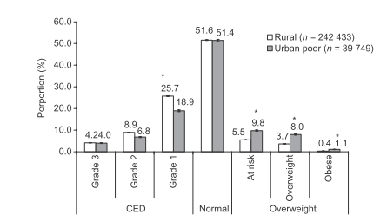
Bar Charts
Categories on horizontal axis
Vertical bar for each category, height of bar represents frequency
Shafique S. et al., Trends of under- and overweight among rural and urban poor women indicate the double burden of malnutrition in Bangladesh, Int.J.Epi., 2007; 36:449-457

Slide 24
Histograms
One of most common graphs of numerical data – unlike bar graph can be used for discrete and continuous data.
A histogram is like a bar graph, with values grouped in intervals (classes for discrete, bins for continuous) on x-axis
Effectively, the histogram has both x and y-axes as numerical – therefore the area, not height, is the crucial metric here!

Slide 25
Histograms: warning
The number of classes / the bin size can distort the data – we must be careful when selecting a bin size!
Example: Systolic Blood Pressure
190 persons, age 40-59
Different numbers of classes

Slide 26
Selecting Bin Size
Look for natural divisions in the data – e.g. if we’re dividing exam marks, can we have the bins as grade boundaries?
Try and keep all bins the same size & include all the data – outliers can skew, so these must be treated carefully.
Use whole numbers and numbers divisible by the same size if possible (e.g. for 20 samples, use a bin size of 5 – not 6 or 7!)
If comparing data sets, use same binning parameters – this makes the two sets directly comparable.

Slide 27
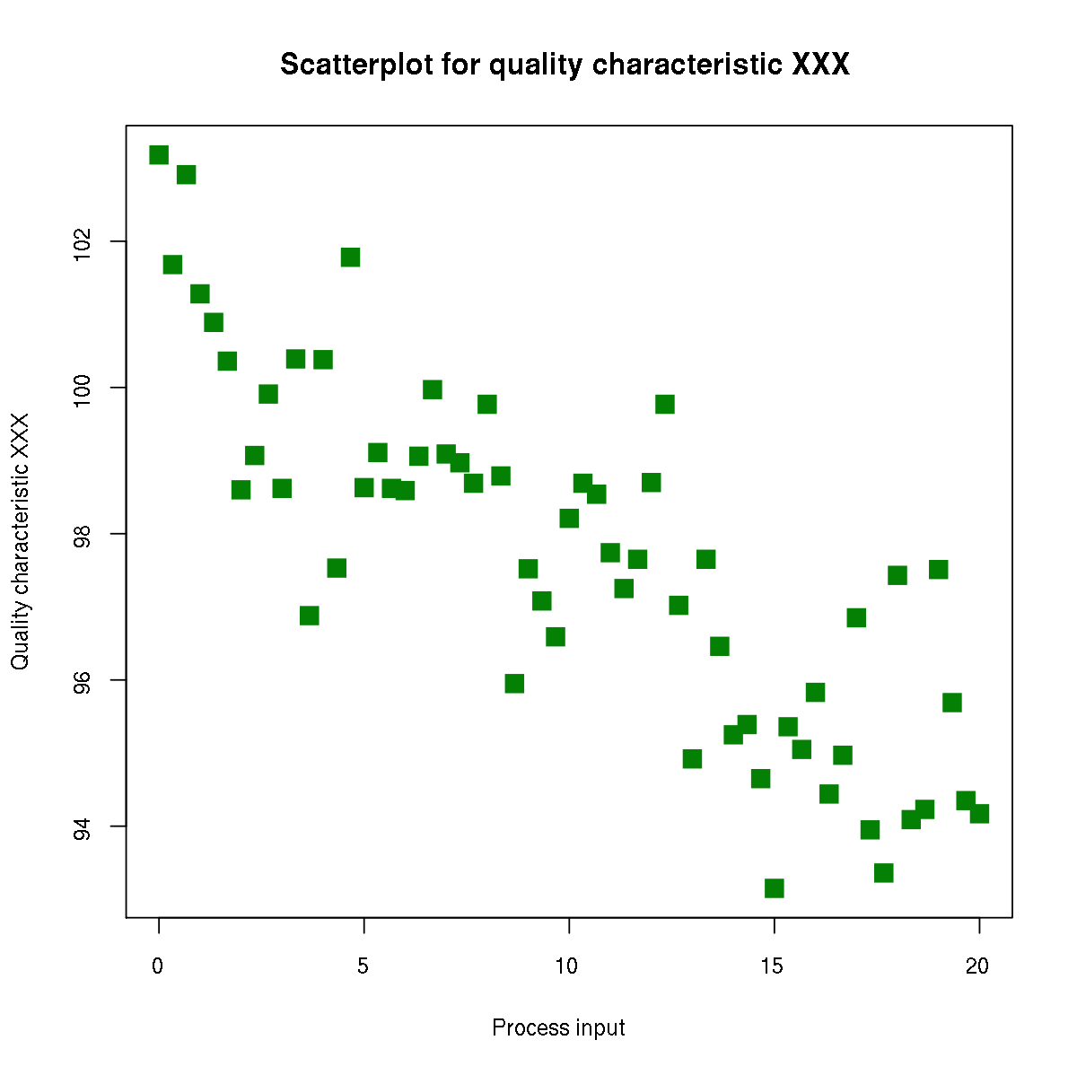
Scatter plot
We can display two variables simultaneously using a scatter plot (e.g. x vs y)

Slide 28
3. Descriptive statistics

Slide 29
Example (contd.)
Need to quantify the effects of interest:
BMI
Soft drink consumption
We also need to quantify the dispersion e.g. are the variations between individuals too great to draw a definitive conclusion?

Slide 30
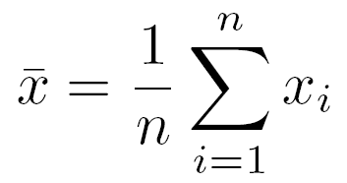
Arithmetic mean
Denote data by x₁, x₂, …, x_{n}
Arithmetic mean given by
Can be used for both continuous and discrete data – not for categorical data

Slide 31
Mean: Example
You are investigating the Body Mass Index for people with different diets
24.1 23.5 18.5 16.7 26.3 28.5
Diet 1: low consumption of fizzy drinks, n=10
25.2 23.4 22.5 29.9
= (24.1+23.5+18.5+16.7+26.3+28.5+25.2+23.4+22.5+29.9)/10 = 23.9
Diet 2: high consumption of fizzy drinks, n=12
22.1 20.5 18.5 16.9 24.1 26.0
22.2 28.4 21.5 31.9 23.0 17.2
= (22.1+20.5+18.5+16.9+24.1+26+22.2+28.4+21.5+31.9+23+17.2)/12 = 22.7

Slide 32
The Median
Median is the middle observation - such that 50% of data lies below its value. Order the data and select the middle value (if n is even, take the midpoint of the middle two values)
Main advantage of median over arithmetic mean is insensitivity to outliers (extreme points).
This is also the main disadvantage…

Slide 33
Median: Example
Same example as before, let’s concentrate on Diet 1
24.1 23.5 18.5 16.7 26.3 28.5
Diet 1: low consumption of fruit/veg, n=10
25.2 23.4 22.5 29.9
Order the data
16.7,18.5,22.5,23.4,23.5,24.1,25.2,26.3,28.5,29.9
n is even, so we need to take the 5th and the 6th observations
5th obs = 23.5
6th obs = 24.1
Med = (23.5+24.1)/2 = 23.8

Slide 34
The Mode
Mode is data value or category occurring most frequently.
Insensitivity to outliers.
Particularly useful for qualitative data and for discrete data – when fractional values don’t make sense
e.g. favourite football team
There may be more than 1 mode.

Slide 35
Variability
People differ in their characteristics (physical activity, socio-economic status, genetic predisposition, etc…)
→ BMI will vary between people with the same diet
We want to quantify whether the difference in BMI is due to fizzy drinks, other factors, or a combination of the two?
Sources “not of interest” are treated as random variability / dispersion
Must take random variability into account when drawing conclusions.

Slide 36
Measures of Dispersion
Entirely possible for two data sets to have same mean, median and mode but look very different…
Measures of dispersion aim to characterise degree of spread or variability within data set.

Slide 37
Quantifying variability in data
Quartiles: divide the distribution in 4 equal parts.
1st quartile =25th percentile, 2nd = 50th percentile (median), 3rd ⁼ 75th percentile
Diet 2: high consumption of fruit/veg, n=12
22.1 20.5 18.5 16.9 24.1 26.0
22.2 28.4 21.5 31.9 23.0 17.2
Order the data
16.9 17.2 18.5 20.5 21.5 22.1 22.2 23.0 24.1 26.0 28.4 31.9
1st quartile: 3rd obs = 18.5
2nd quartile (Med): 6th and 7th obs = (22.1+22.2)/2 = 22.15
3rd quartile: 9th obs = 24.1

Slide 38
Inter Quartile Range - IQR
Inter-quartile range: (3rd – 1st quartile) 25th to 75th percentile.
Not sensitive to outliers, but only uses central 50% of observations

Slide 39
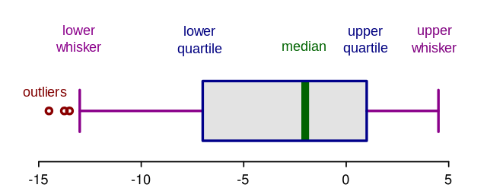
Box (and Whisker) plots
Graphical summary of the distribution of a quantitative variable
Median (50th percentile) is marked as central line
Box represents the quartiles (25th and 75th percentiles)
Whiskers mark the max. and min. values <1.5 x IQR from the box
Outliers (>1.5 x IQR from the box) marked as separate lines/points

Slide 40
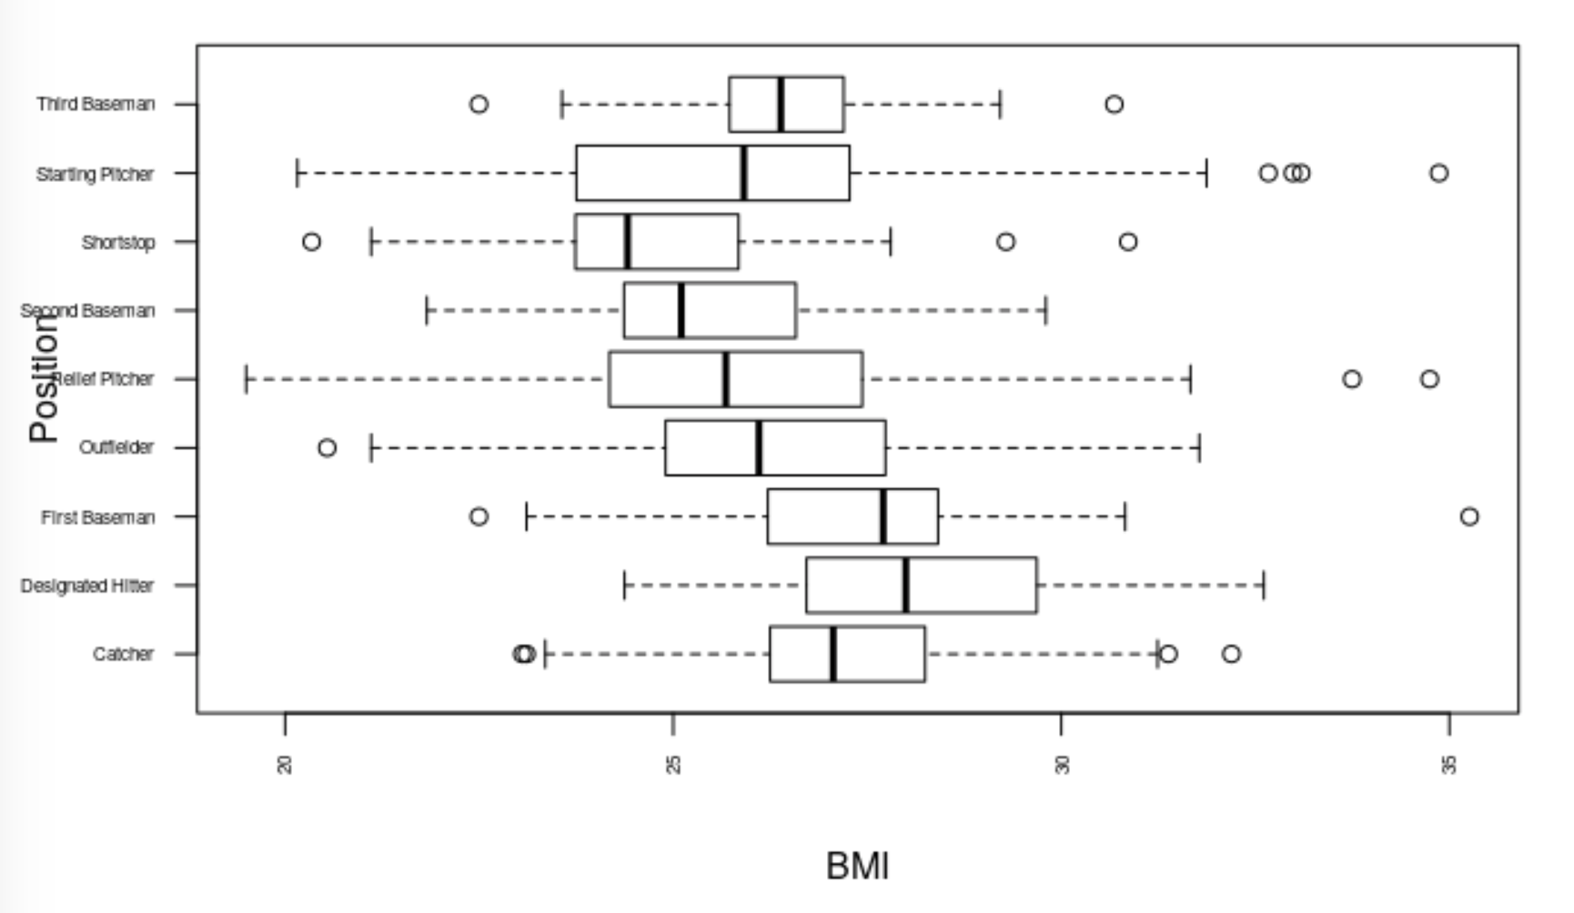
Box (and Whisker) plots

Slide 41
The Variance
Variance quantifies amount of variability or spread around the sample mean.
The variance of n observations, x₁,…,x_{n}, is defined as

Slide 42
Example
You are investigating the Body Mass Index for people with different diet
Diet 1: low consumption of fruit/veg, n=10
24.1 23.5 18.5 16.7 26.3 28.5
25.2 23.4 22.5 29.9
= 23.9
(24.1-23.9)² + (23.5-23.9)² + (18.5-23.9)² + (16.7-23.9)² +(26.3-23.9)² +
(28.5-23.9)² + (25.2-23.9)² + (23.4-23.9)² + (22.5-23.9)² +(29.9-23.9)²
sd²=
= 16.45
(10-1)

Slide 43
Standard Deviation (SD)
Rather than use variance, more common to report its square root or standard deviation as this is in the same units as observations, i.e.
From the previous example sd =
16.45 = 4.05
Standard deviation is very sensitive to outliers

Slide 44
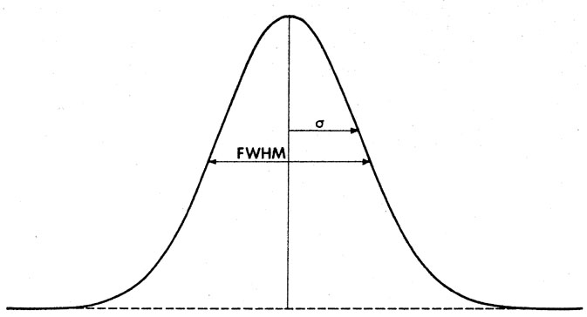
Other Measures Exist…
Full-Width at Half Maximum – the width of a “normal” distribution (more on normal distributions in very soon!)
2.4 σ = FWHM (for a Normal distribution)

Slide 45
Shapes of a distribution
Skewness measures symmetry around the mean
Positively skewed → long right tail.
Negatively skewed → long left tail.
Symmetric → equal tails
If skewed, median and IQR are preferable

Slide 46
Correlation of two variables
If a relationship exists between two variables (e.g. BMI and blood pressure), we say that they have a correlation, or dependence.
We are often interested in establishing whether a linear relationship exists between two things.

Slide 47
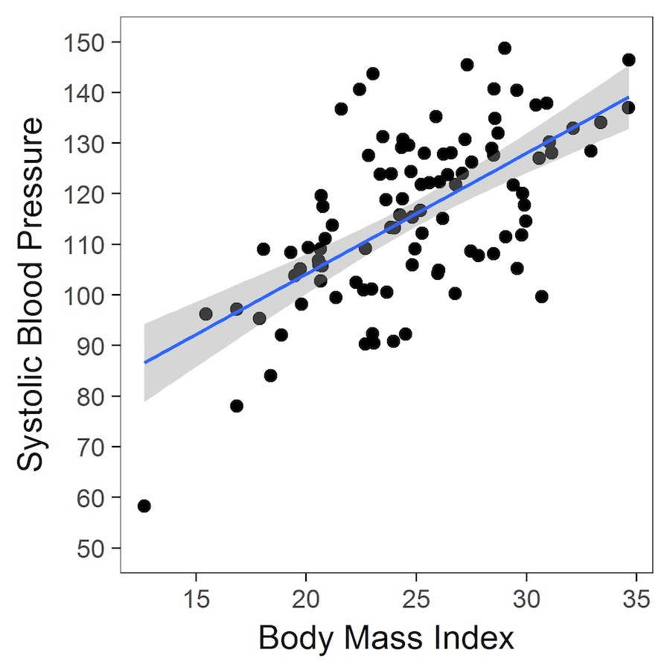

Slide 48
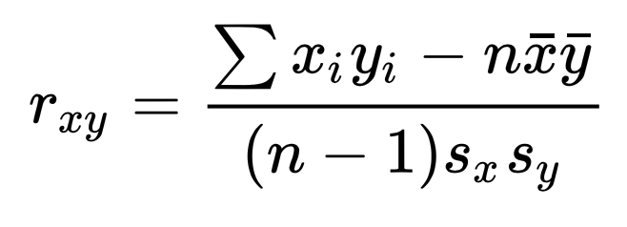
Pearson Correlation Coefficient
One method of calculating the correlation is the Pearson Correlation Coefficient
Here, 𝑠_{x} and s_{y} are the standard deviations of x and y respectively
Any value greatly above 0.5 is considered “correlated”.

Slide 49
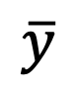
Example
We start with a set of two variables, (x , y)
(10, 4) (8,8) (2,7) (9,5) (9,4) (7,8)
= 7.25
$$\overline{y}$$
= 6.0
(10-7.25) + (8-7.25) + (2-7.25) + (9-7.25) + (9-7.25) + (7-7.25)
x (4 - 6) + (8 - 6) + (7 - 6) + (5 - 6) + (4 - 6) + (7 - 8)
1
r =
= -0.5488
4 - 1
(9.688) x (2.5)
This would be considered “weak negative correlation”. Therefore, there is likely a weak relationship between the variables

Slide 50
Descriptive stats - summary
Describe the data (tables and plots)
Summarise the data (Mean, Median, Mode)
Measure the variability in the data (inter-quartile range, variance, SD, FWHM)
Quantify the strength of associations between variables (Pearson correlation coefficient)

Slide 51
4. The Normal distribution

Slide 52
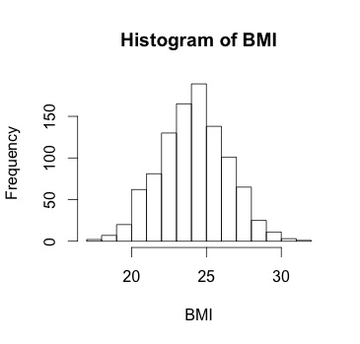
Distributions
The larger the sample size, the smoother we expect the histogram to become.
We could use a smooth curve through a histogram to represent the probability distribution of this variable for the population studied.
This is a kind of statistical model.

Slide 53
Distributions
The equation of the smooth curve representing the histogram of BMI would be a convenient mathematical shorthand for representing probability distribution of BMI.
In general for continuous variables, the distribution can be a complex equation.
But, it turns out that the distribution of many continuous variables can be approximated by a standard distribution with known properties:
Normal (Gaussian) Distribution

Slide 54
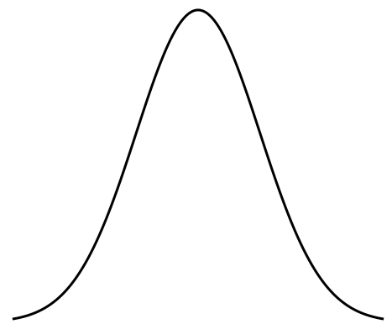
The Normal Distribution
The Normal distribution has the shape of a “bell curve” with parameters μ and σ² that determine the center and spread:
σ
μ

Slide 55
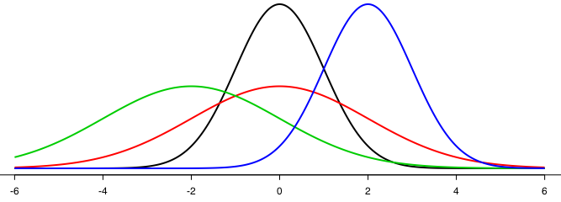
Different Normal Distributions
Each different value of μ and σ² gives a different Normal distribution, denoted N(μ,σ²)
If μ = 0 and σ² = 1, we have the Standard Normal distribution
N(0,1)
N(2,1)
N(-2,2)
N(0,2)

Slide 56
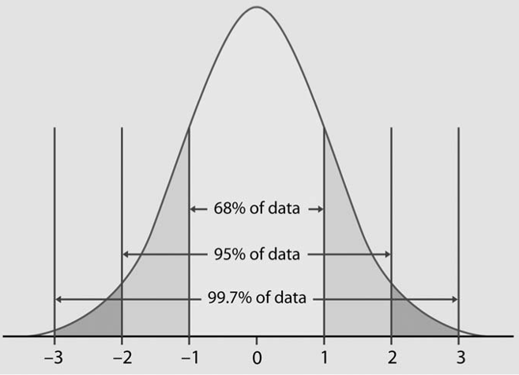
Properties of Normal Distributions
Normal distribution follows the 68-95-99.7 rule:
68.27% of observations are between μ - σ and μ + σ
95.45% of observations are between μ - 2σ and μ + 2σ
99.73% of observations are between μ - 3σ and μ + 3σ
σ
2σ

Slide 57
Uses of the Normal Distribution
Using the Normal distribution as a model for the population behaviour, we can use it to answer questions like
Does this population have a larger/smaller mean than another population? (e.g. cases vs controls)
Does this population have a larger/smaller variance than another population?
We use hypothesis testing to answer these types of questions and potentially show a statistically significant difference between two data sets.

Slide 58
5. Your turn

Slide 59

Abalone dataset

Slide 60
Abalone dataset
Use appropriate plots to present the distributions.
Summarise the data using whatever statistics you think appropriate.
Investigate possible dependencies between the variables.

Slide 61
5. Statistics in life and research

Slide 62
“Most people use statistics like a drunk man uses a lamppost; more for support than illumination”
― Andrew Lang

Slide 63
Data fallacies
Can you think of some examples of how statistics are
misinterpreted in daily life?
deliberately used to mislead people?
misapplied in scientific research?

Slide 64
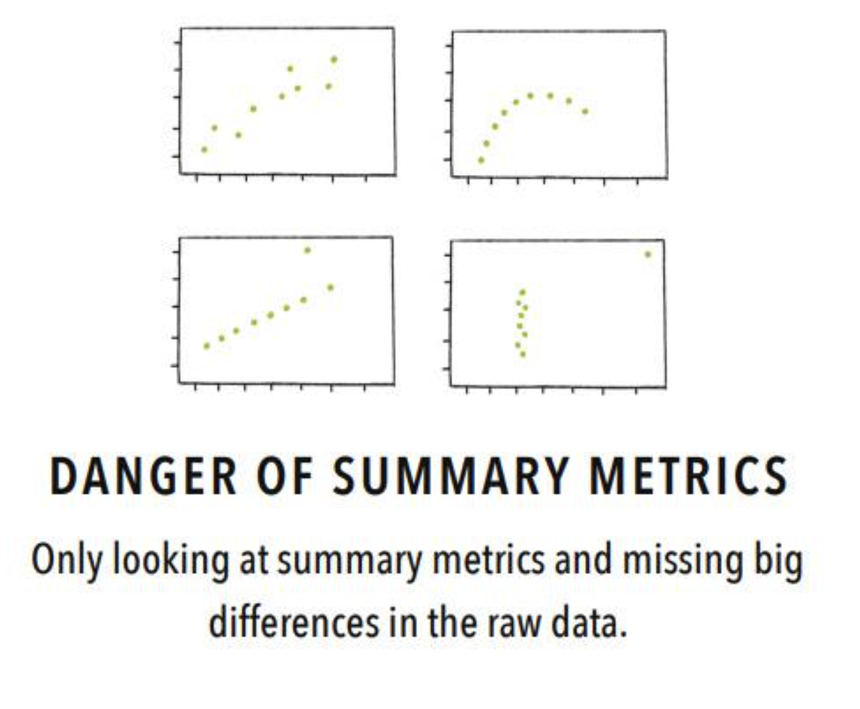

Slide 65
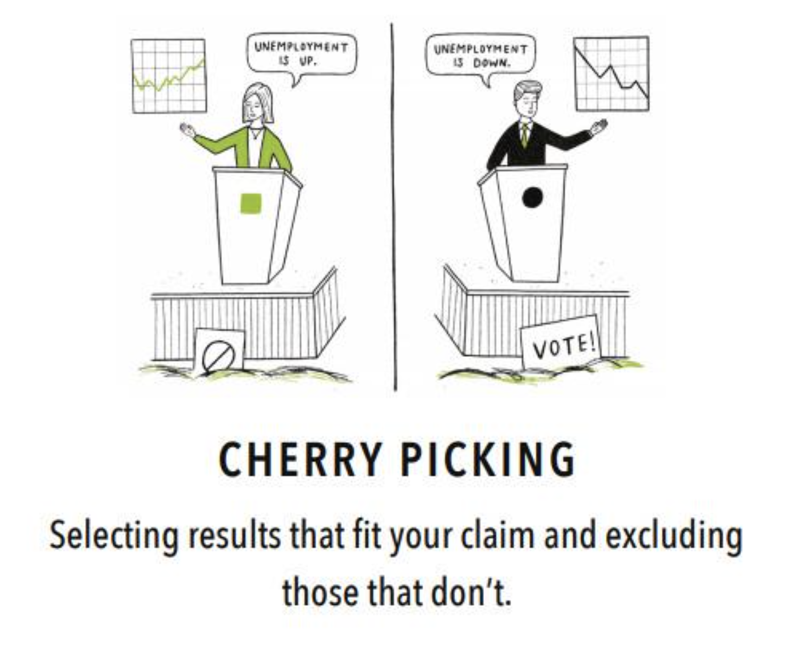

Slide 66
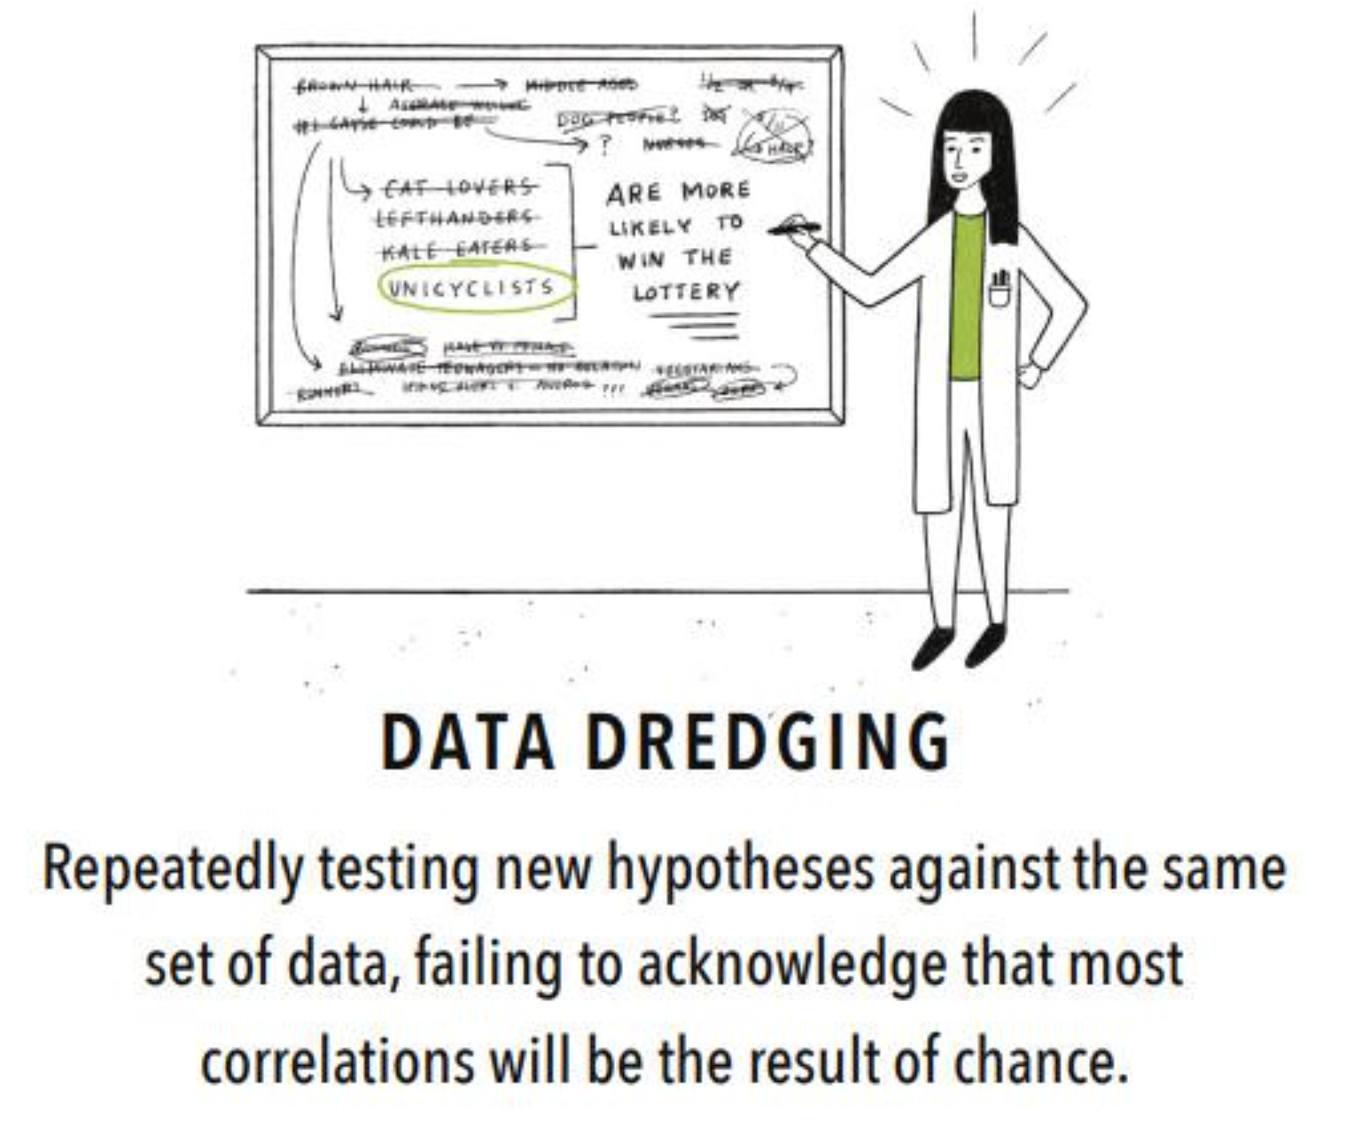

Slide 67
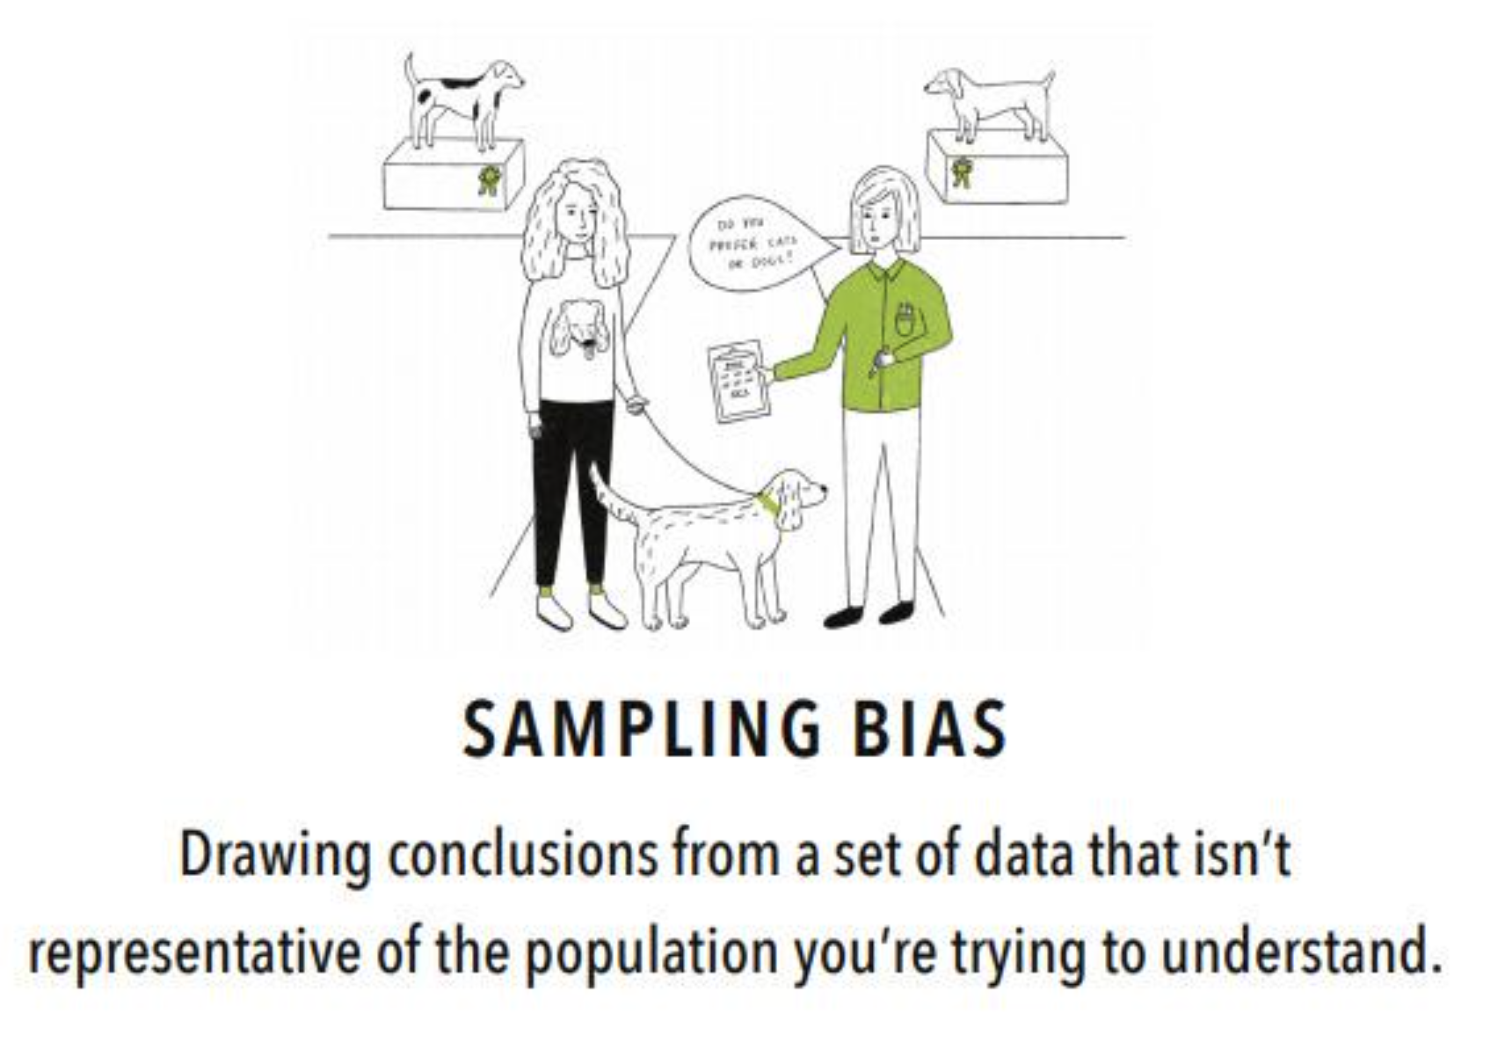

Slide 68
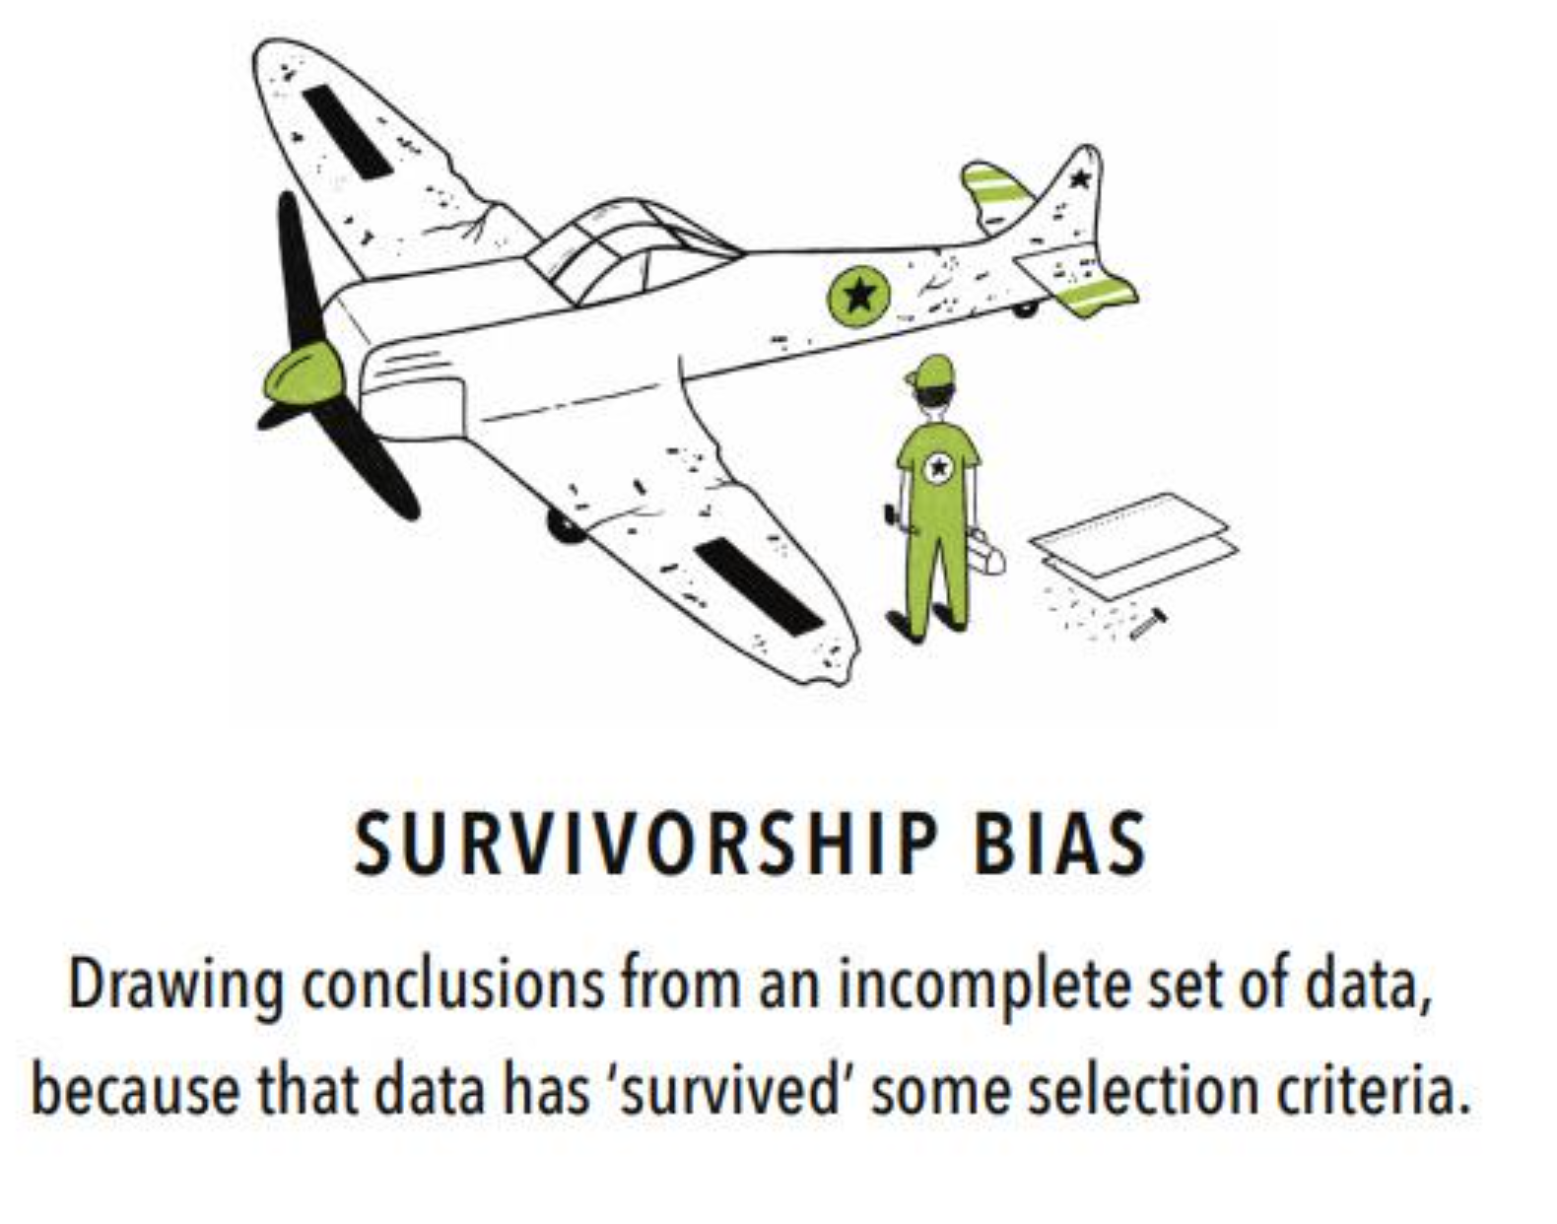

Slide 69
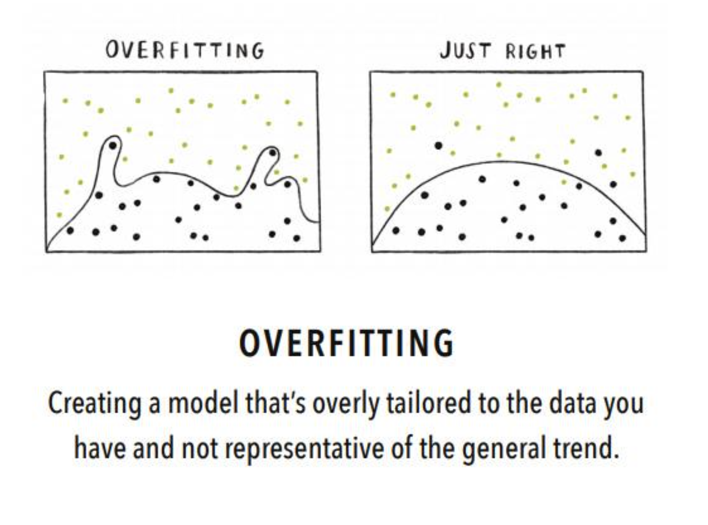

Slide 70
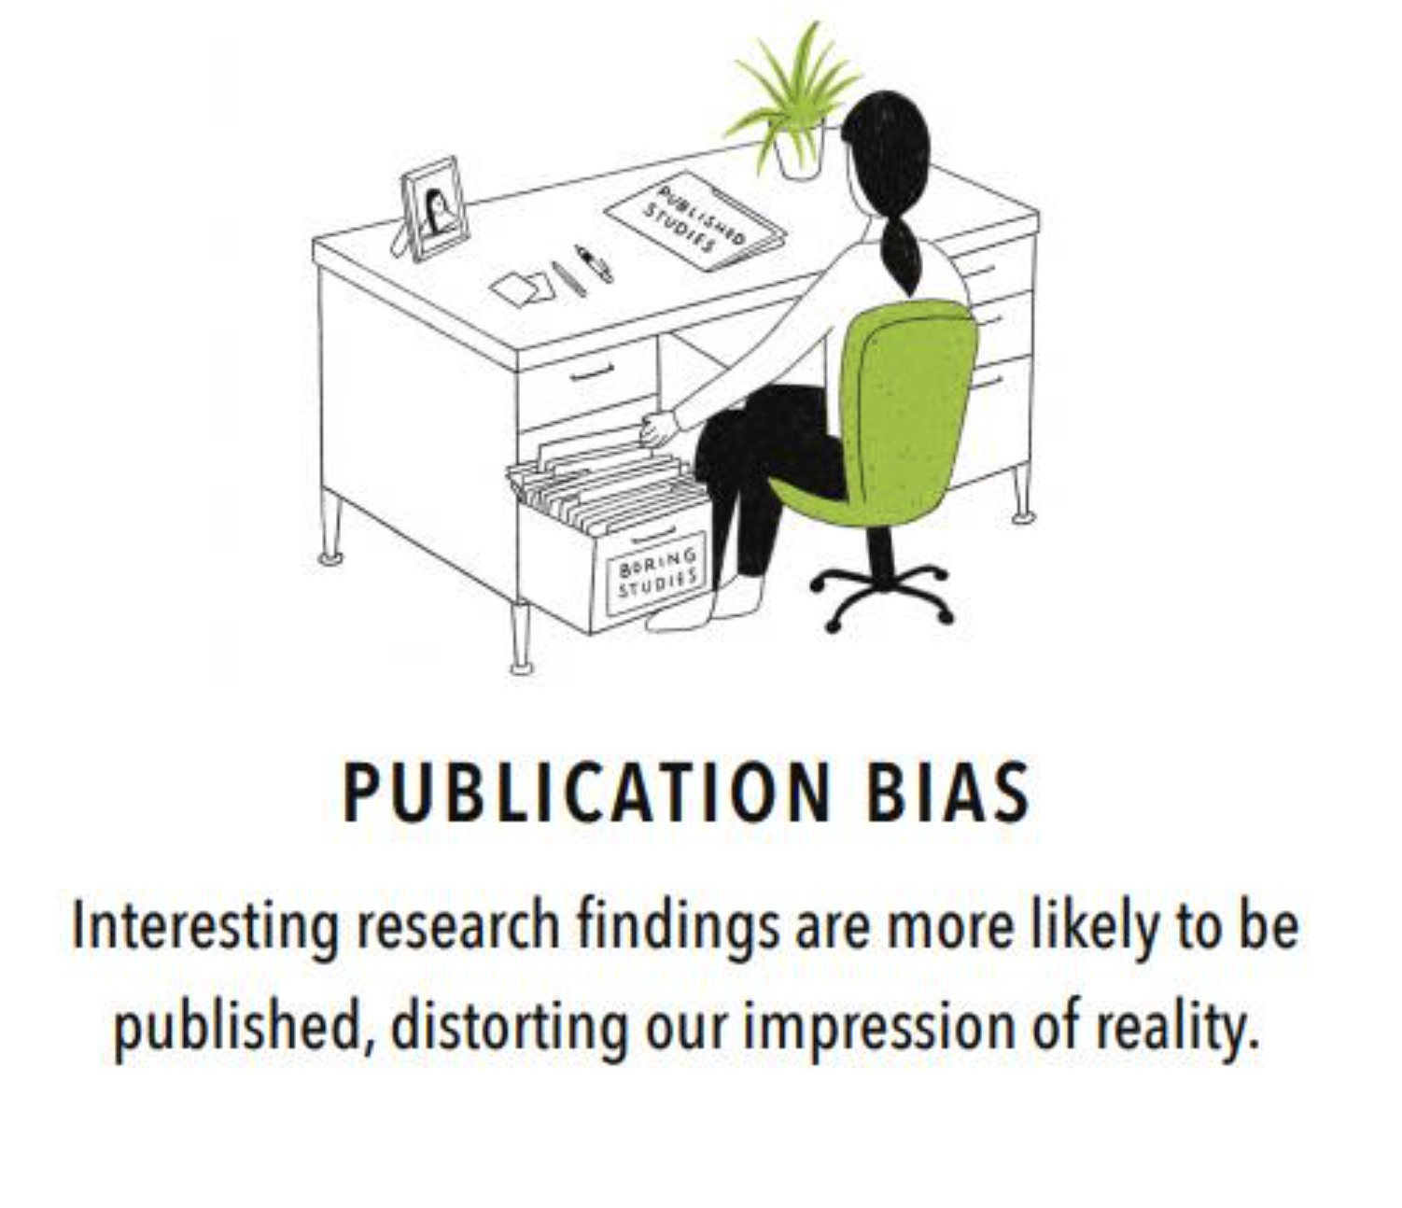

Slide 71
Correlation vs Causation
Y
X
What’s the difference between correlation and causation?

Slide 72
Correlation vs Causation
Causation means one event is the direct result of another e.g. when I flick the light switch, it causes the light bulb to turn on.
Correlation means two events or variables are associated e.g. people who cycle more often are more likely to be vegetarian.
Does correlation imply causation?
Does causation imply correlation?
How can we test whether X causes Y?

Slide 73
Experimental design
How can we test whether X causes Y?
With a well-designed experiment, it is possible to control for causative factors other than those being tested. Positive results then allow us to infer causal relationships.
This may require
Random sampling
Double blinding (to counter the placebo effect)
Appropriate choice of sample size

Slide 74
When does inference go wrong?
Several factors influence our ability to make inferences from a sample to a population:
1. The sample may be biased, i.e. not representative of the population as a whole.
2. By chance alone the sample may differ, to a greater or lesser extent, from the population.
3. Using the wrong statistical methodology

Slide 75
1. Avoiding Bias
Kinds of samples:
sample of convenience (possibly biased)
random sample (eliminates bias): every person in the population has an equal chance of being in the sample
stratified random (eliminates bias across strata)
Numerous types of bias to be aware of – selection, dropout, recall ,etc.
Slide 75
© Imperial College London

Slide 76
2. Chance
We cannot do anything about the second factor (chance), and we must always remember that chance alone could have given our observed finding.
(But if our sample is large enough, we can be confident that our sample mean is a good estimate of the population mean!)
We must therefore quantify the uncertainty in our estimates of the population parameters.
Slide 76

Slide 77
3.Wrong method
Even if the sample is representative of the target population, using the wrong statistical method to analyse the data leads to invalid statistical inference.
Example: when comparing the mean between two groups, a hypothesis test may give incorrect conclusions if its assumptions don’t hold true for the data analysed.
Slide 77

Slide 78
Future Classes
Moving forward with statistics
Some other Graduate School courses you may find helpful:
Data exploration and visualisation
Introduction to sampling and hypothesis testing
Regression modelling
R Programming

Slide 79
Future Classes
Further reading
“Points of Significance” series of articles from Nature Methods
http://blogs.nature.com/methagora/2013/08/giving_statistics_the_attention_it_deserves.html

Slide 80
Papers used for the examples
Shafique S. et al., Trends of under- and overweight among rural and urban poor women indicate the double burden of malnutrition in Bangladesh, Int.J.Epi., 2007; 36:449-457
Yadav and Krishnam, Changing patterns of diet, physical activity and obesity among urban, rural and slum populations in north India, 2008; Obesity Review, 9:400-408.

Slide 81
Acknowledgements
These slides are based on an earlier version of the course, developed by Brett Thomas.
Data Fallacies examples taken from data-literacy.geckoboard.com

